Slide 1
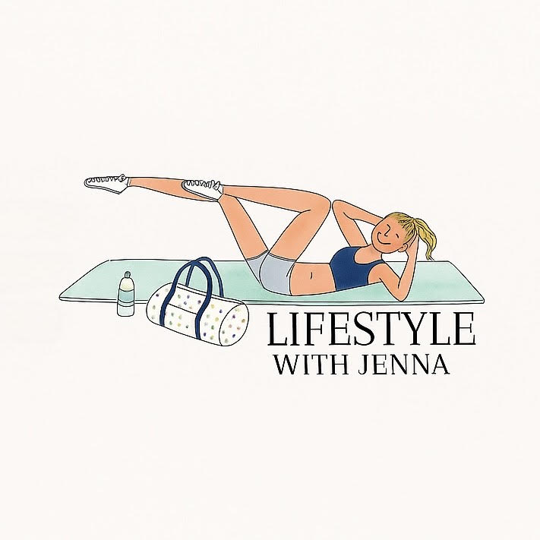
Lifestyle With Jenna
Social Media Marketing Project

Slide 2
Project Overview & Overall Goals
Social media influencer profile
Create content focused on health, wellness, and lifestyle balance for college students and young adults
Tracked engagement, views, and followers to see what content performed best
Spread motivation and positivity across all platforms
My goal was to post relatable, useful content that would inspire small lifestyle changes in others

Slide 3
Social Media Marketing Strategy
Post three times per week across all platforms
Post casual, authentic content that feels personal but inspires consistency
Shared mix of videos, articles, quotes, personal content
Used trending hashtags and keywords
Focus on approachable tips instead of perfection

Slide 4
Did I Reach My Goals?
Yes – engagement and reach increased
YouTube had the biggest growth
Received positive comments
Built community on Instagram and Facebook
Posted thought out, brand-specific, consistent content each week

Slide 5
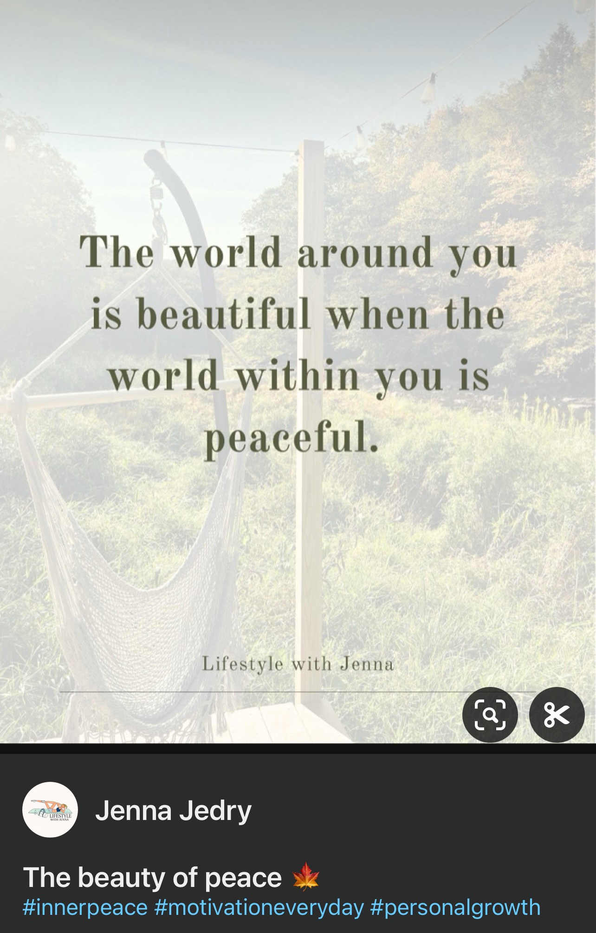
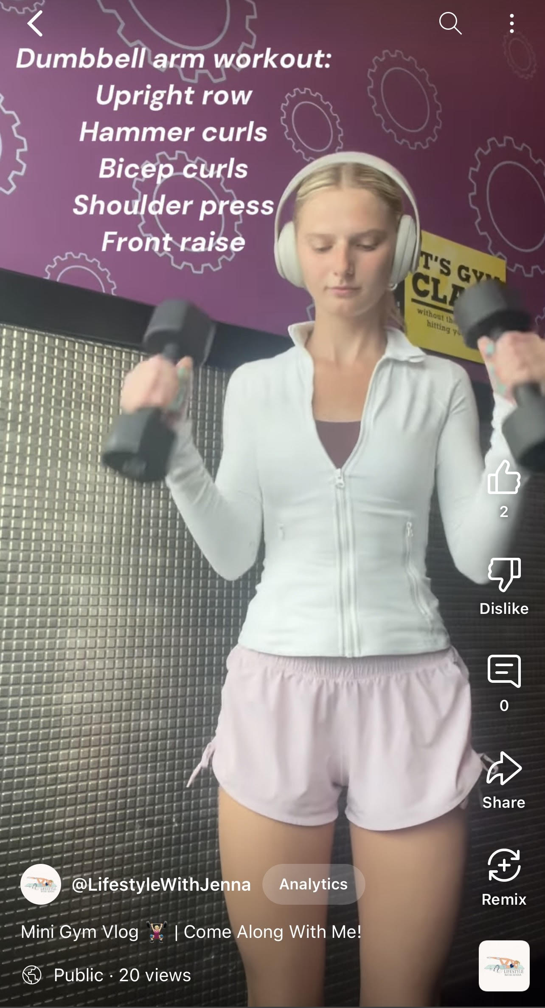
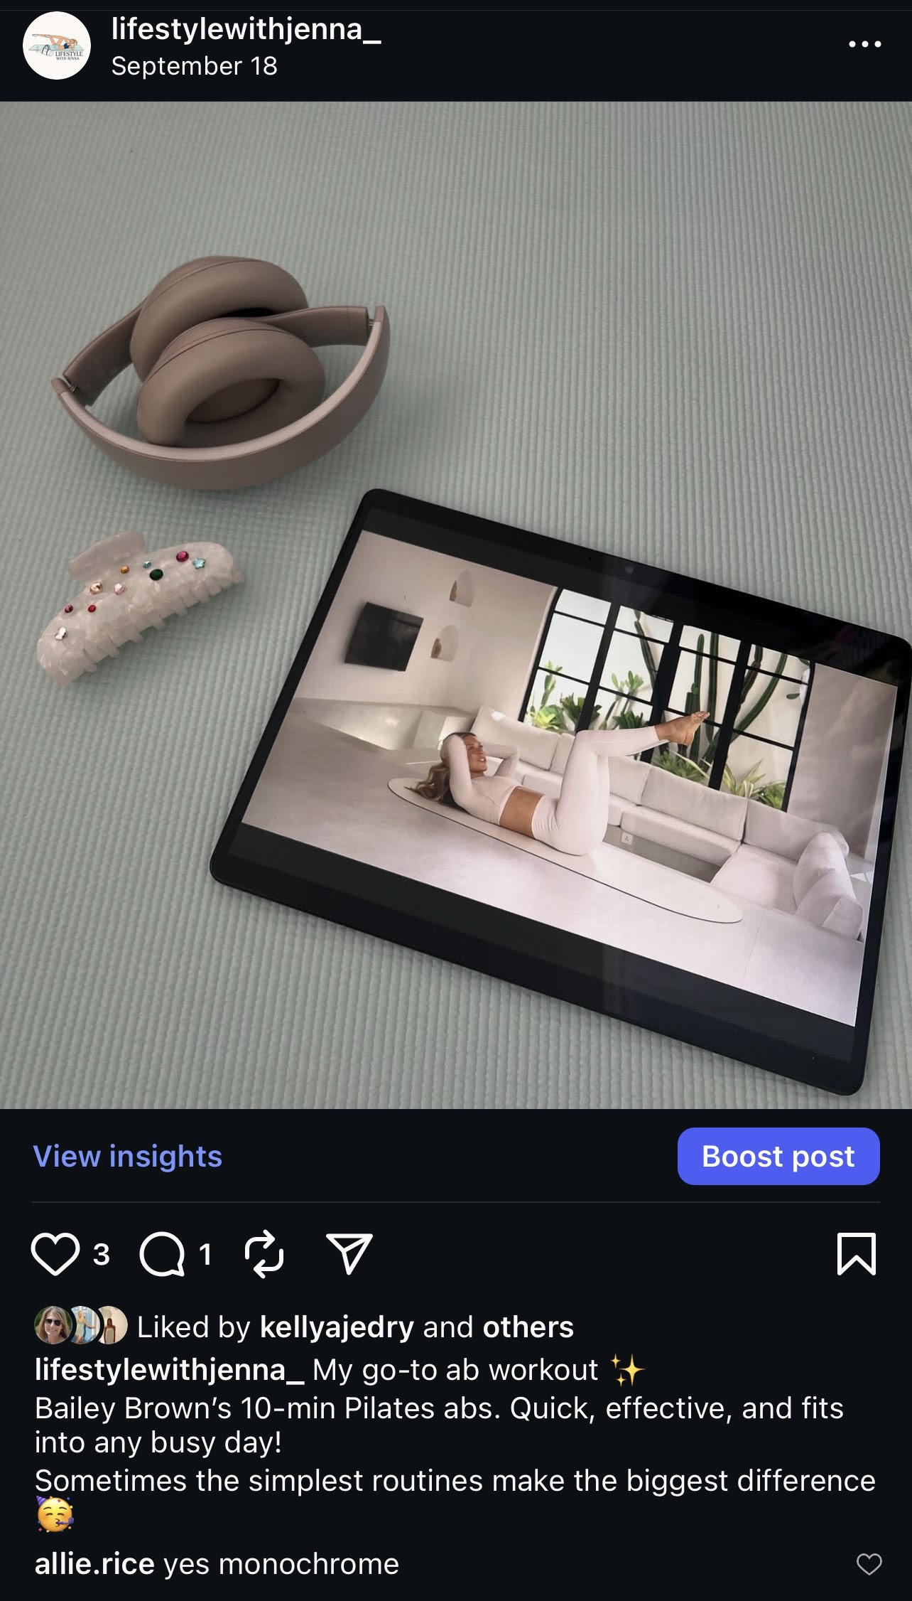
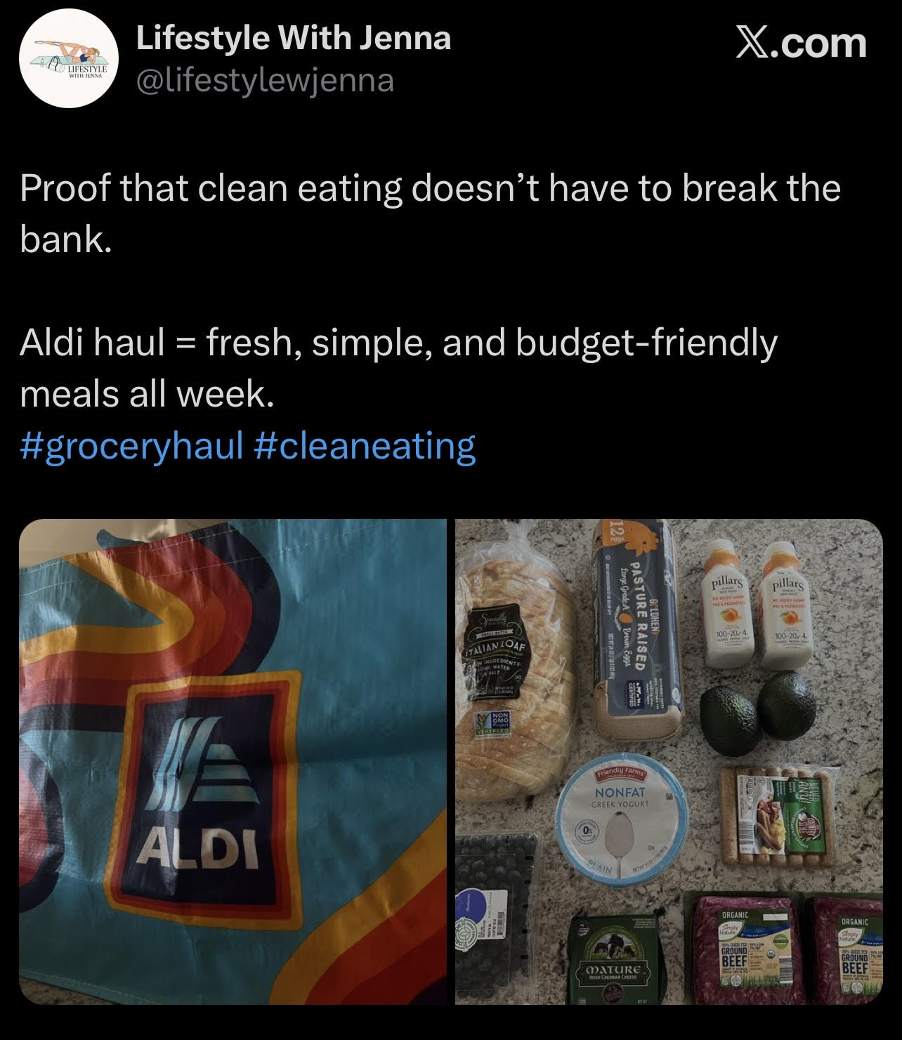
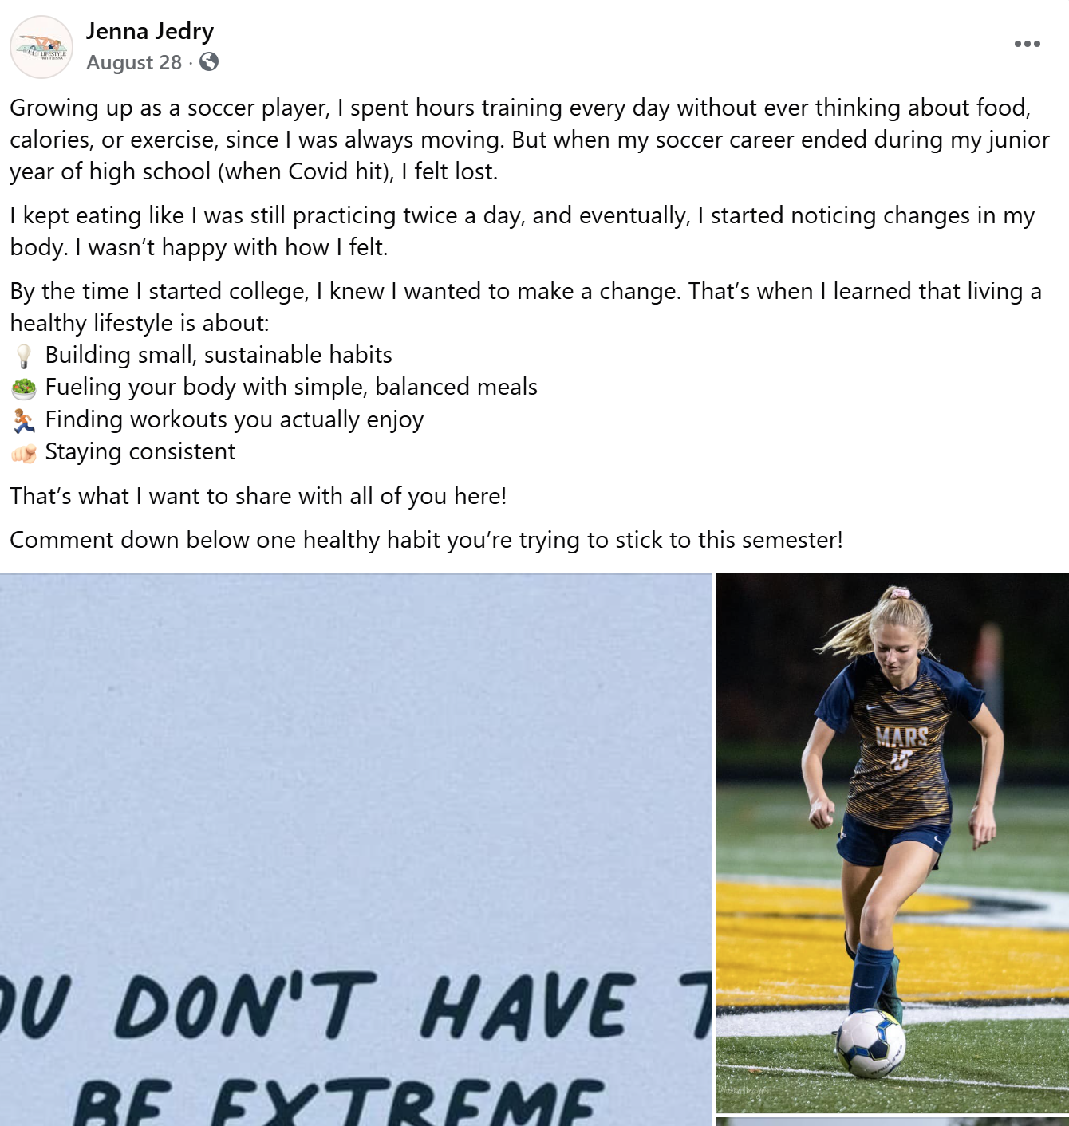
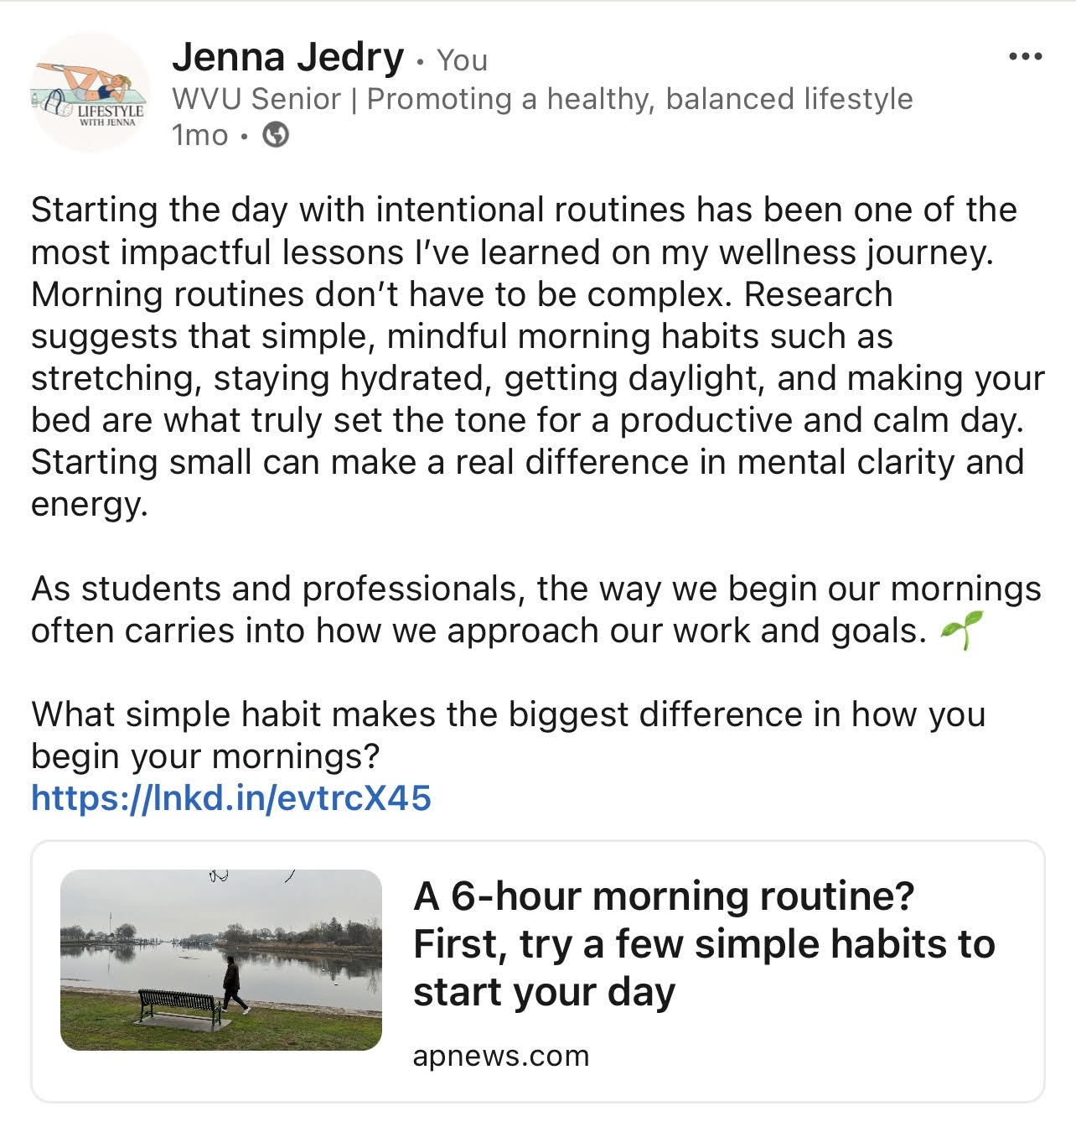
Examples of Daily Posts
Pinterest
YouTube
Instagram
Twitter (X)
Facebook
LinkedIn

Slide 6
Reverse Engineering
Took inspiration from lifestyle + wellness creators like Mary F, Grace Terrell, and Whitney Simmons
Focused on their simple, motivating, and easy-to-follow content style
Used clean, aesthetic vibes
Kept posts real and relatable to a busy college lifestyle
Aimed for content that feels authentic, balanced, and achievable

Slide 7
The Message Behind My Posts
Post Goals
Post Tone
Motivate and influence viewers
Promote a healthy lifestyle
Encourage small changes
Build connection
Motivational
Friendly and casual
Inspiring and uplifting
Relatable “college lifestyle”

Slide 8
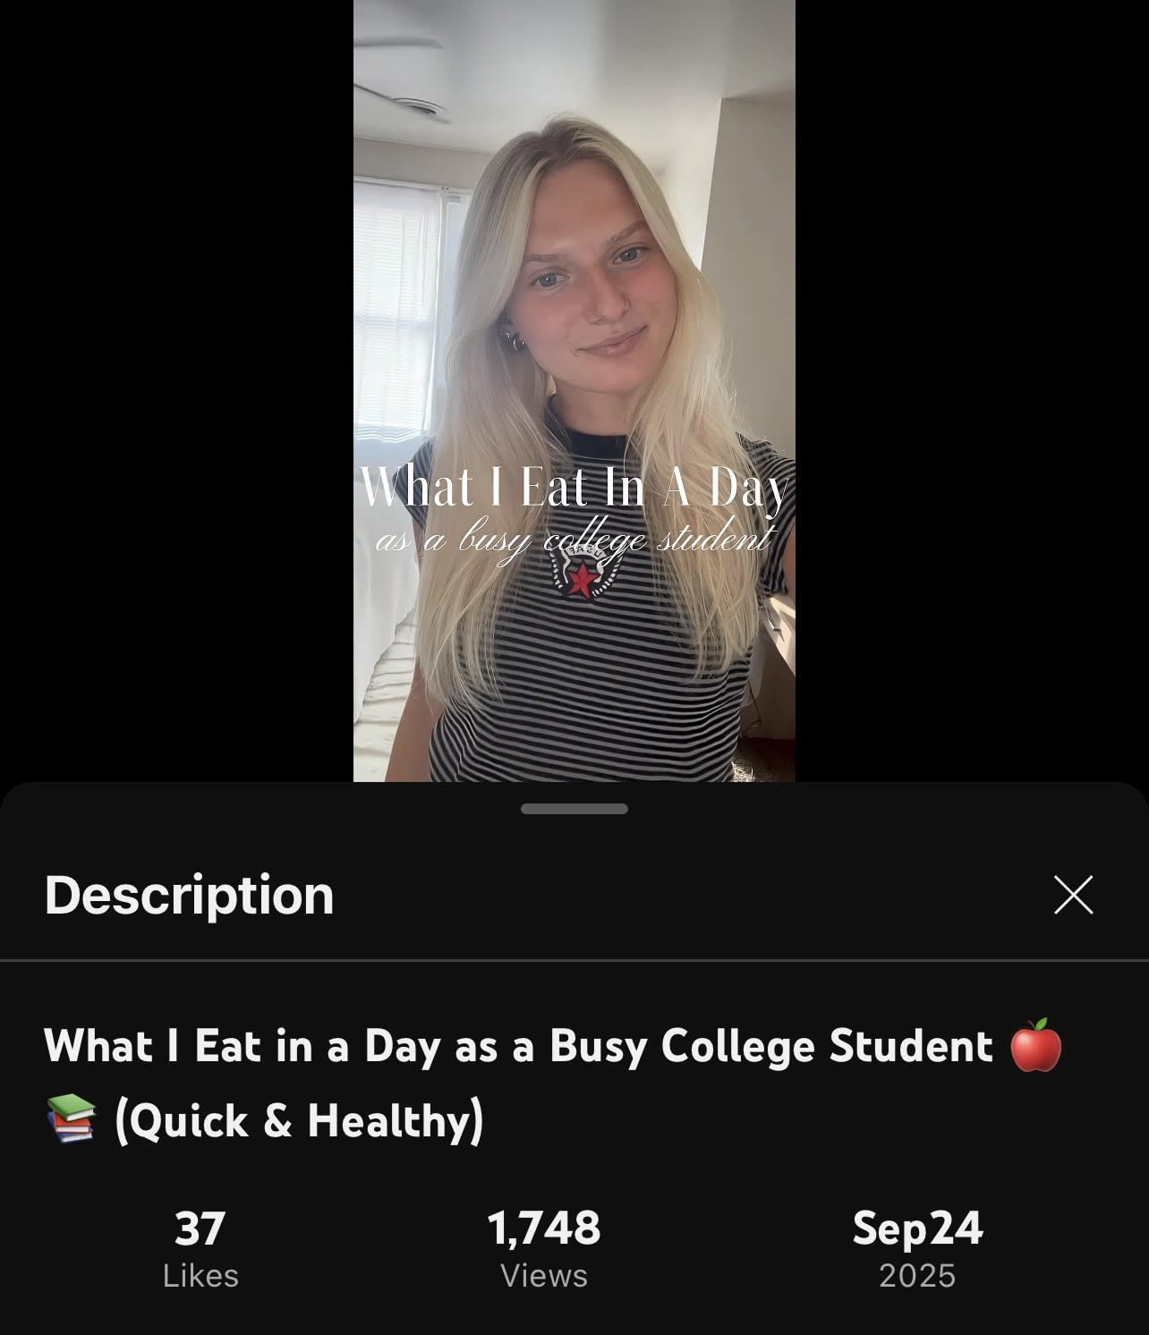
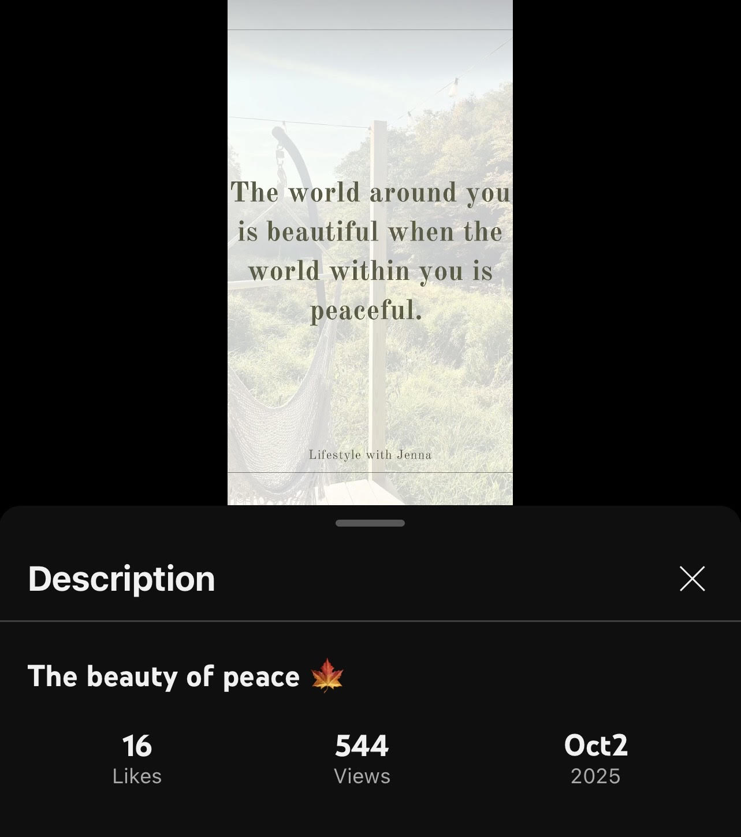
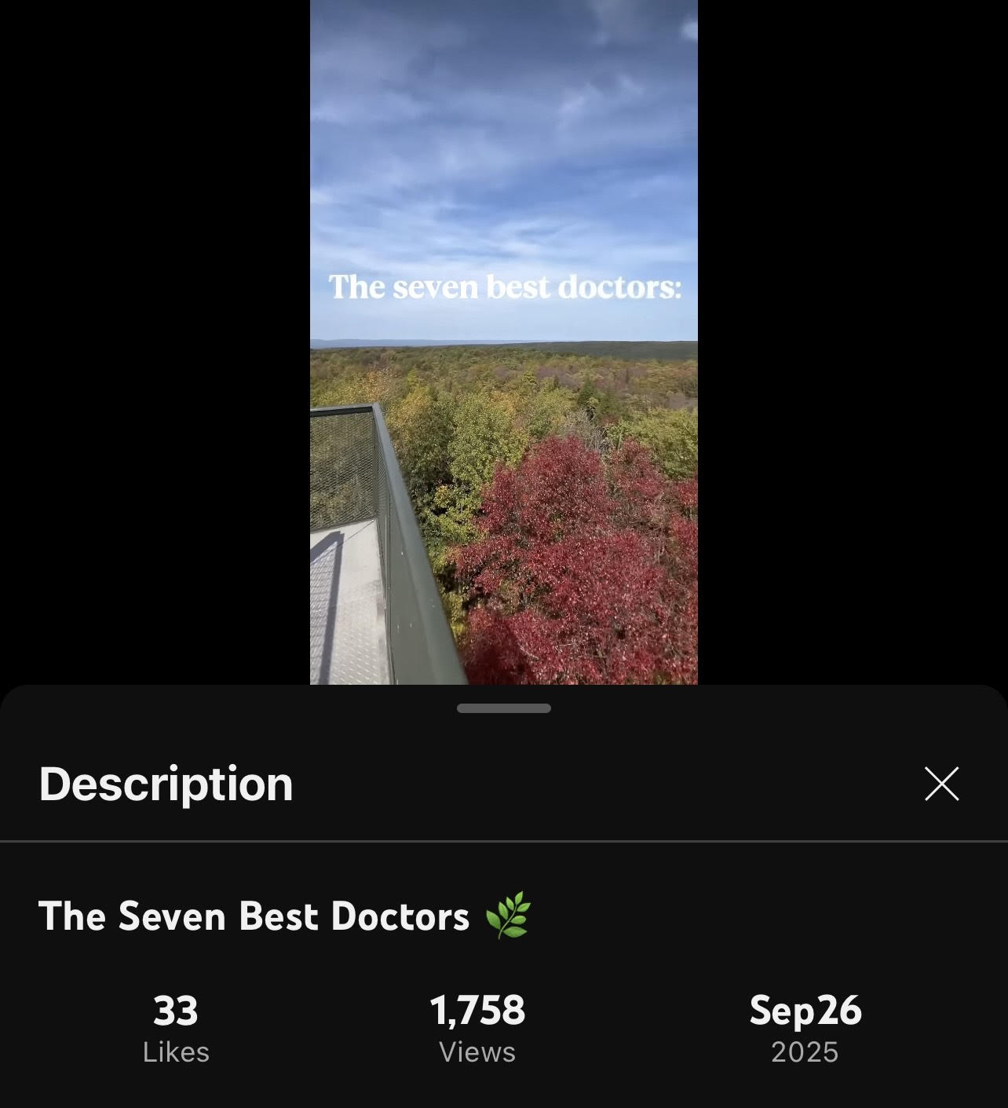
Best Performing Posts
YouTube Shorts worked the best for me, specifically 10-25 second videos. These shorts had the most engagement out of all posts on every platform. They helped me achieve my goals because I received high engagement not only on YouTube, but on all platforms from these videos. I gained followers and subscribers, and received likes, comments, and shares. The videos were personal to me, which showed viewers my authentic self.

Slide 9
Best Platforms
YouTube Shorts
Instagram & Facebook
Performed the best overall in reach and engagement
The “7 Best Doctors” and “What I Eat in a Day” videos gained over 1,700 views each
30+ likes on both
Quick videos to watch
Personable, real content, upbeat music, editing skills
Gained followers and had high views
Aesthetically pleasing
Most comfortable with Instagram
Facebook felt personable
Worked well for repurposing YouTube content
Reached friends and family, helping boost interaction through likes and comments

Slide 10
Analytics Insights
What I Learned From The Data:
How Analytics Shaped My Strategy:
I learned that videos perform the best
Personal content received high views
Hashtags increased engagement
Posting around the same time engages viewers
Incorporated my life into content
Continued to mix motivational and lifestyle themes, which consistently performed well
Posted earlier in the day
Casual + peaceful content

Slide 11
What I Learned About Social Media Marketing
Engagement can be unpredictable
Staying consistent makes a huge difference
Some platforms just work better for my style of content
Possibility of negative comments

